Slide 1
TGD3351 Game Algorithms
Trimester 1 2015/16
Game Algorithms Project
Spell Alchemy: The Fortress Escape
Presented by
Chia JianFei 1131120642
LIm Wan Ping 1121119034

Slide 2
Game Overview
Spell Alchemy: The Fortress Escape is a basic hide-and-seek game.
The stage was set as Chandler is inside the fortress and spotted by Dark Wizard.
To escape the fortress, Chandler must use the invisible spell on specific location, provided that location have enough power to conceal his presence towards Dark Wizard.
To win this game, player must make his way to the exit with all the quest items collected.
The game score will then be computed based on the time taken to finish the stage mission and also the number of bonus stars looted.

Slide 3
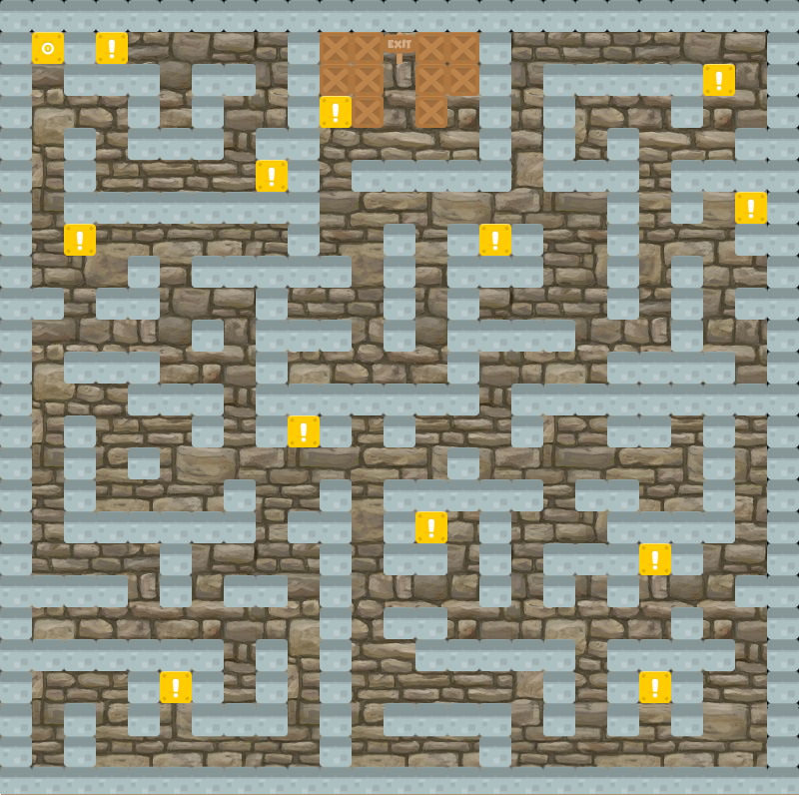
Game Design
Level Design

Slide 4
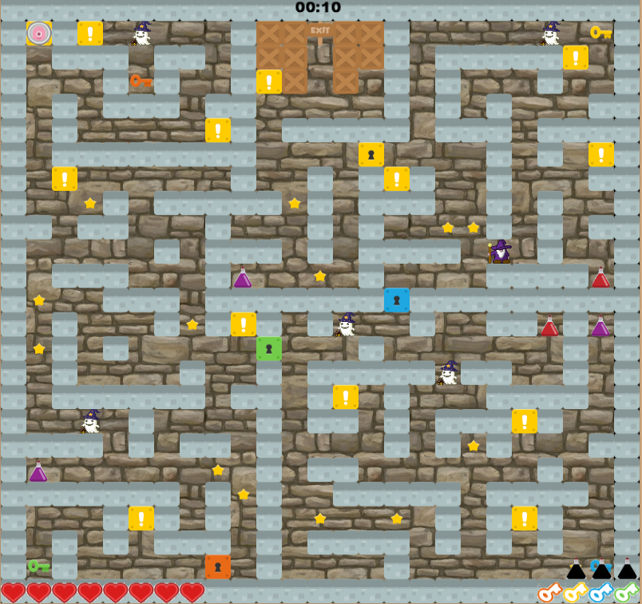
2) Level Design with HUD & Object Layout

Slide 5
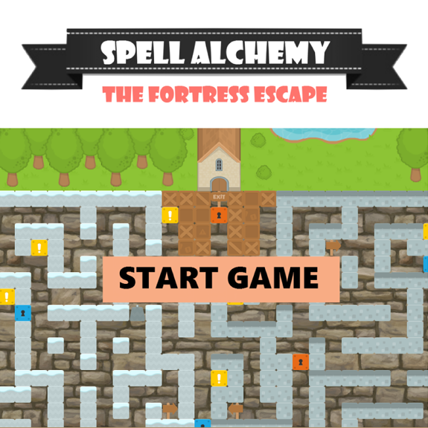
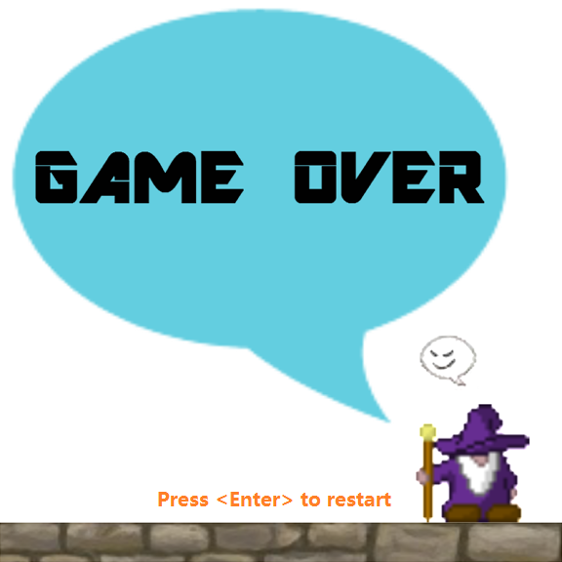
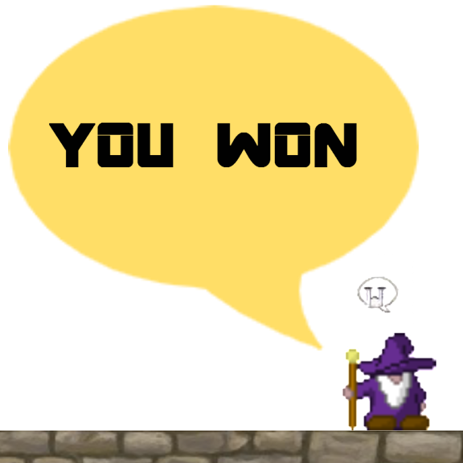
3) Home Screen 4) Game Over 5) You Won

Slide 6
Technical Design
Wall/Block Detection
One of the core technical implementations in tile-based game.
All movement are implemented with unit synchronization (one unit equal to one tile, instead of pixel).
Find the position of the wall, based on current tile position and the map references.

Slide 7
Path finding Algorithm
A* algorithm.
The algorithm searches and adds the adjacent walkable tiles into Open List and compute their cost to the destination.
Once the computation is finished, the algorithm will pick the lowest cost alphabetically or sequentially and add that tile to Close List.
The algorithm is prototyped using the pseudo code, provided at the in the lecture and the youtube lecture on this topic. The reference link is as follows: https://www.youtube.com/watch?v=-L-WgKMFuhE

Slide 8
Finite State Machine
A Finite State Machine is introduced in this game on the AI (Wizard and Minions). The involved states including wonder, chasing, line of sight chase (follow) , and stop. All these action are based on player’s hiding status or is in line of sight.
Wizard AI Behaviour
To improve the thrilling fun factor of the game, the wizard will be constantly on chase mode to chase after player. He will switch to wander mode only if the player is hiding in the hideout.
Minion AI Behaviour
Minions will move back and forth between 2 points in their respective designated patrolling path that is technically calculated with a Starting Patrolling Position and the coverage of the path.

Slide 9
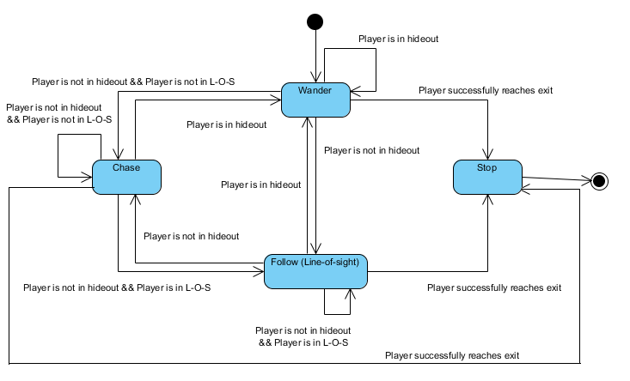
Finite State Machine for Wizard AI

Slide 10
Score System
The score is computed using the following formula:
Score = Estimated finishing time (in seconds)/Total finishing time (in seconds) * 100 + Number of stars looted * bonus marks a star carries

Slide 11
Game Development Issues
Attraction Point
The main attraction point of this game is the hide-and-seek mechanics itself. As the almighty Dark Wizard will keep chasing after player when he is not in the hideout, the difficulty designed has provided a significant boost to the thrilling fun factor to the game.

Slide 12
Changes Made
1) Coins mechanisms that can be used to unlock special abilities -> Star mechanisms for bonus score calculation.
Reason: Such ability might decrease the difficulty of the gameplay, which makes the concept of hiding become optional, and not a key feature.
2) The idea of implementing Checkpoints is removed.
Reason: Low priority and time constraints.
3) Wizard now does 3 damages to the player upon contact instead of killing the player instantly.
Reason: Tuning is done here because It is extremely difficult to play if the player is instantly killed upon touching the wizard.

Slide 13
4) Penalties are removed, and power-up are altered. Instead of placing “Illusion” or “Invisible” power-ups, “HP potions” are implemented.
Reason: it can make the hard game even harder.
“HP potions” are implemented to decrease the game difficulties.
5) The idea of alchemy is simplified into collecting multiple key items to leave the fortress, instead of mixing the items to obtain the key item.
Reason: Time constraints.

Slide 14
Discussion
If more time is given in this project:
Few elements can be developed better to enrich the player’s gameplay experience, including
Adding different types of minions, different moving and decision making behaviours.
Increasing more level designs
Implementing more power-ups
2. Incorporate a fusion system to the current existing simplified alchemy system,

Slide 15



User Manual
* At the home screen, simply left click or press space on the keyboard to start the game.
The player ( )can move by using arrow keys (Up, Down, Left, Right) or using ‘WASD’ key similar to arrow keys.
Your mission is to collect all spell items ( ) in the fortress and make your way out to the exit without getting captured by the dark wizard ( ). The player can make use of the enchanted location ( ) as hideout to avoid being detected by the dark wizard.
There is a time limit (few seconds) you can stay in a hideout, exceeding the time limit would force you out of it.

Slide 16

3. There is red potion in the fortress, when looted, it will give player’s HP a cure.
4. Random stars scattered around the fortress that are meant to add bonus marks to the game score.
5. The game score will vary depending on the total time player spend on clearing the stage and the number of stars looted.

Slide 17
Demo
/
Q&A

